Slide 1
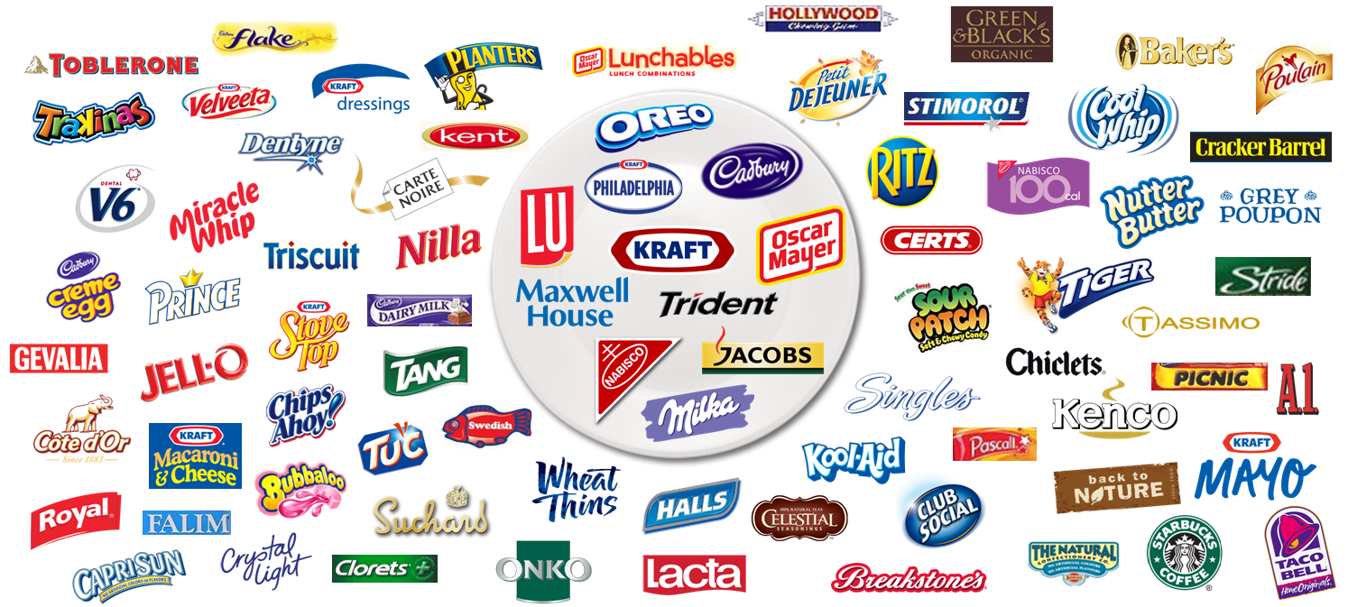
Kraft Foods
Apurva Jindal
Lakshya Kumar
Michael C Joseph
Yash Upadhyay

Slide 2
Company Introduction
Strategy Analysis
Cadbury Acquisition
Post-Acquisition Analysis
Vulnerabilities
Recommendations

Slide 3
Company Introduction

Slide 4
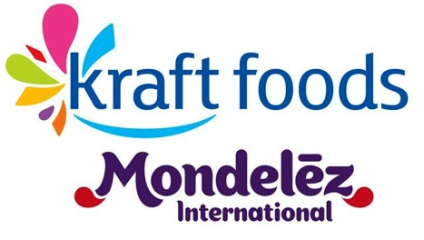
Introduction
Founded by James Kraft in 1903, KRAFT FOODS Inc. is a manufacturer of consumer foods listed on the NYSE. The company is headquartered in the Chicago suburb of Northfield, Illinois. Currently, Kraft operates in more than 155 countries. In 2012 it changed its name to Mondelez International, keeping the name Kraft Foods Group for business in North America.

Slide 5
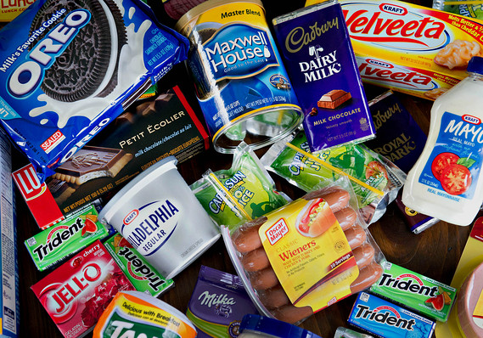
Introduction
Approximately $48 billion in revenue
World’s No.2 food company (Rankings led by Nestle), No.1 in North America
Mondelez International holds the No. 1 position globally in Biscuits, Chocolate and Candy. (source: Euro monitor)
Sales in 155 countries, Operations in more than 70 countries
Features eight billion-dollar brands: Cadbury, Cadbury Dairy Milk, Milka chocolate, LU, Nabisco Oreo biscuits, Tang powdered beverages, and Trident gum.

Slide 6

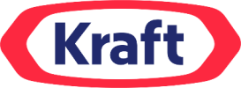





Mission and Vision
“Their VISION is to be the number one food and beverage company in the customers mind, recognized by the quality and variety of the healthy products that they offer. “
High Price
“Their MISSION is to provide excellence in healthy and nutritious products with innovation, high technology and high quality. In order to satisfy consumer needs, providing permanent welfare and quality of life, and also taking into account the health of the environment. “
High Quality
Low Quality
Low Price

Slide 7
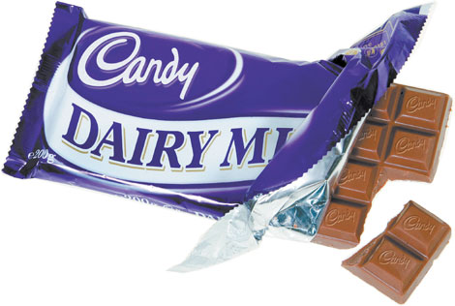
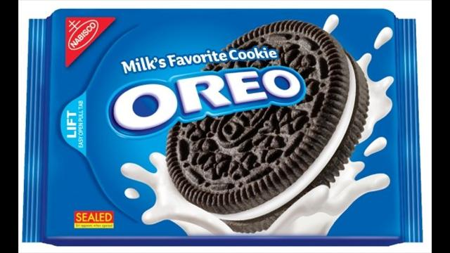
Marketing Strategy
PRODUCT PORTFOLIO
One of Kraft's aims is to ensure that its products become consumers' first choice. To achieve this, Kraft has identified and developed a range of distinctive key brands which are known within the company as its Power Brands.
The major element in managing and developing these Power Brands to ensure that they provide more value for consumers.

Slide 8
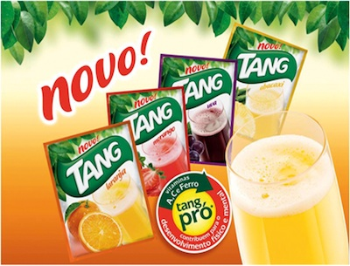
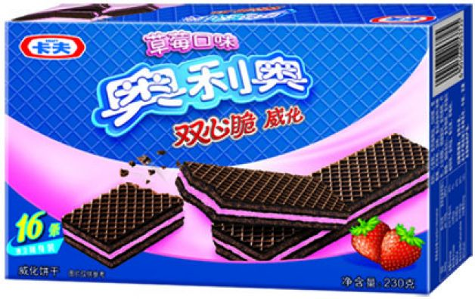
Marketing Strategy
GLOBAL APPROACH:
In Latin America, Kraft Foods spend around $50 million annually on flavours alone across their Tang business. Their research team identified which flavours were most preferred by consumers and then partnered with a single supplier to tailor a winning product assortment.
After learning that Oreo cookies were too sweet, too big and too expensive for Chinese consumers. Kraft Food created unique Oreo varieties in China that are tailored to local tastes, while based on a great global platform. Today, they make locally relevant flavours like Oreo Green Tea Ice Cream and more affordable forms, like wafers.

Slide 9
Marketing Strategy
BCG Matrix
STARS
Oreo Biscuits
Cadbury Diary Milk
Oscar Mayer Hotdogs
Trident Gums
QUESTION MARKS
Homestyle Deluxe Mac and Cheese
Corn Nut
Stride Shift Gums
CASH COWS
Tang Powdered Beverages
Jacobs Coffee
A1 Steak Sauce
Philadelphia Cream Cheese
DOGS
Bull’s Eye Barbeque Sauces
Saimaza Natural Ground Coffee

Slide 10
Acquisition of Cadbury by Kraft

Slide 11

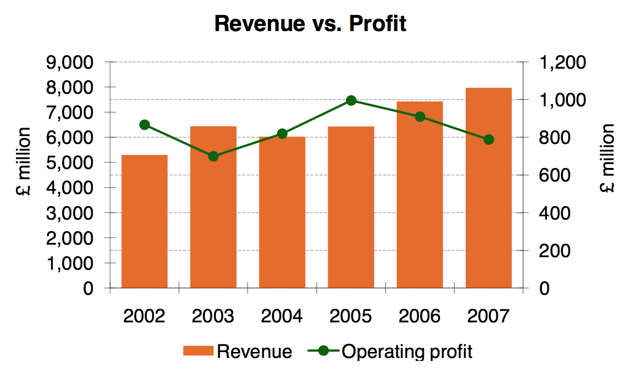
Cadbury
Key Highlights
Established | 1824
Headquarters | Uxbridge, London, United Kingdom
Sector Involvment | Confectionery, bakery products, ice cream, dairy products, snack bars, canned/preserved food, spreads
Major Markets | Europe and Asia
Revenue | £5.4 billion (2008)
Brief History
1824: The Company was founded by John Cadbury
1969: Merger with Schweppes
2003: Name Rebrand
2007: Demerger of Cadbury Schweppes
2010: Kraft Foods acquired Cadbury

Slide 12
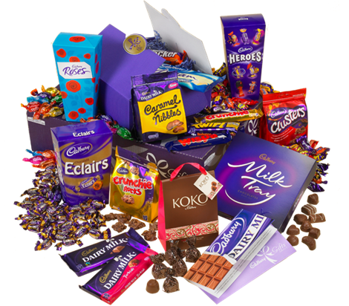
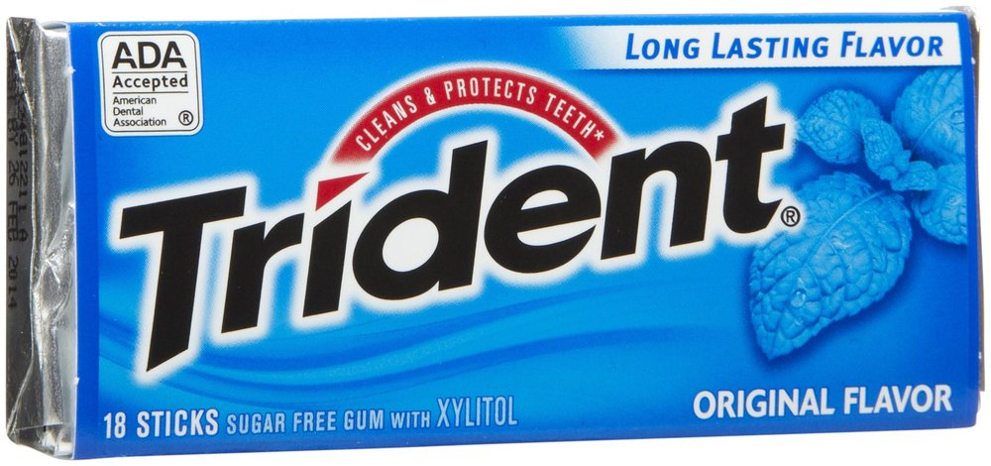
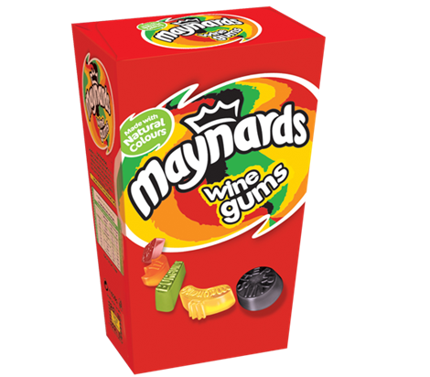

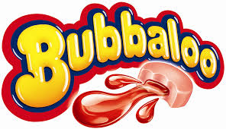
Main product segments
Halls, Maynard’s, The Natural Confectionery Co. and Cadbury Eclairs
Cadbury Dairy Milk, Cadbury Creme Egg, Flake and Green & Black’s
Trident, Hollywood, Stimorol, Dentyne, Clorets and Bubbaloo

Slide 13
Why acquire Cadbury
Entering Emerging Markets
US business was stagnating and Kraft wanted to move to overseas
Highly complementary geographical footprints, Cadbury has strong presence in developing markets like Mexico, South Africa and India. Combination would benefit from improved positions across Europe.
Cadbury's brands were highly complementary to Kraft's portfolio and thus Cadbury would also benefit from Kraft Foods' scope and scale at the global level.

Slide 14
Why acquire Cadbury
Entering Emerging Markets
Barriers to Entry
Established brands:
Nestle, Pepsico etc. are already established in food and beverages
Kraft alone would have to spend a fortune on S&M to enter those markets
Strong name of Cadbury in emerging markets would result in cost saving and easy penetration
Extensive Distribution Channels:
Fragmented supply chain in developing countries
Access to huge networks from the start means huge savings in cost and time

Slide 15
Why acquire Cadbury
Entering Emerging Markets
Barriers to Entry
Increased Market Power
Joint portfolio of more than 40 confectionary brands, each with annual sales in excess of $100 million
Created world’s biggest confectionary company
The deal will help in improvements in operational efficiency, manufacturing and supply chain leading to cost savings to the tune of $675 million

Slide 16
Synergies in form of $675 million Cost savings
Efficiencies and Economies of scale:
Marketing
Media
Selling expenses
Efficiencies and Economies of scale:
Procurement
Manufacturing
Customer service
Logistics
RnD
Efficiencies in the areas of central, regional and country level administrative expenses

Slide 17
Brief Timeline
AUG 28, 2009- Kraft Chairman and CEO Irene Rosenfeld meets Cadbury’s Chairman Roger Carr and offer to buy Cadbury in cash and share deal which valued Cadbury’s shares at 755 pence each but Carr refused the offer.
SEPT 7 - Kraft goes public with the bid, but by this time the value of the same offer had slipped to 745p per Cadbury share, or £10.2bn. Cadbury promptly rejects the bid.
SEPT 12 - Cadbury's Carr in a letter to Rosenfeld again rejects the bid saying it was an "unappealing prospect" being absorbed into Kraft's "low growth conglomerate business".
SEPT 16 - Warren Buffett, the world's second richest man and a leading shareholder in Kraft with a 9.4% stake, warned the US food group not to overpay for Cadbury.
SEPT 21 - Cadbury contacts the UK Takeover Panel to request a "put up or shut up" request be sent to Kraft, which would give a time frame for Kraft to come up with a formal bid.
SEPT 23 - Cadbury chief executive Todd Stitzer is reported at a Bank of America/Merrill Lynch conference as saying he saw some potential benefits from a Kraft deal and discussed valuations with investors, according to a note from the conference.

Slide 18
Brief Timeline (continued)
SEPT 25 - Cadbury's Stitzer says he does not believe Kraft's offer for his company made strategic or financial sense, while Cadbury said his previous remarks had been misconstrued to imply a softening of his views about a deal with Kraft.
SEPT 30 - UK Takeover Panel rules that Kraft has until 5pm on Nov 9 to make a formal offer for Cadbury or walk away for six months. Cadbury reiterates its rejection of the Kraft bid.
OCT 21 - Cadbury posts upbeat third-quarter trading with underlying sales up 7% as it raise its 2009 target for sales and profit margin growth. The shares fail to react as a counterbidder for Kraft is seen increasingly unlikely.
NOV 3 - Kraft's third-quarter results disappoint investors with weaker-than-expected revenue and as it cut its 2009 sales forecast. Rosenfeld says she will not overpay for Cadbury.
NOV 9 - Kraft formalises its bid at the same terms for Cadbury as the original approach – 300p in cash and 0.2589 new Kraft share for each Cadbury share – valued at 717p.
NOV 18 - Both Italy's Ferrero and Hershey said separately they were reviewing a possible bid for Cadbury but gave no assurance that either would make an offer.

Slide 19
Brief Timeline (continued)
NOV 23 - Cadbury shares hits all-time high of 819½p on speculation of a battle between Kraft and rivals for the British chocolate maker.
DEC 4 - Kraft posts its offer document to Cadbury shareholders starting off a two-month fight for the British group under UK takeover rules. Kraft says its bid is now worth 713p a share or £10.1bn.
DEC 14 - Cadbury issues its official defence document promising bigger dividends and strong growth as Cadbury reminds its shareholders that Hershey and Ferrero may bid.
JAN 5, 2010 - Kraft sweetens bid with 60p more cash but cuts shares on offer to keep offer price unchanged.
JAN 12 - Cadbury reports robust trading and rejects the bid on valuation. Ferrero pulls out.
JAN 19 - Kraft seals a deal to buy Cadbury for £11.5bn.

Slide 20
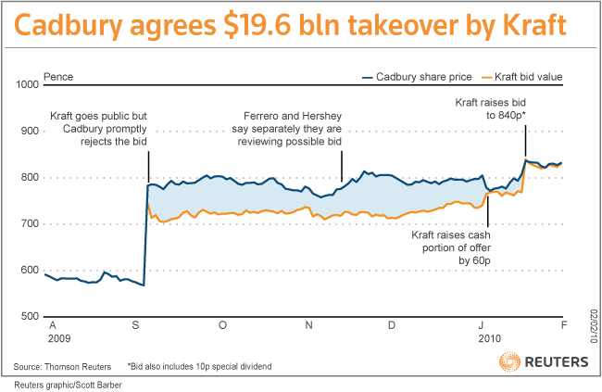

Slide 21
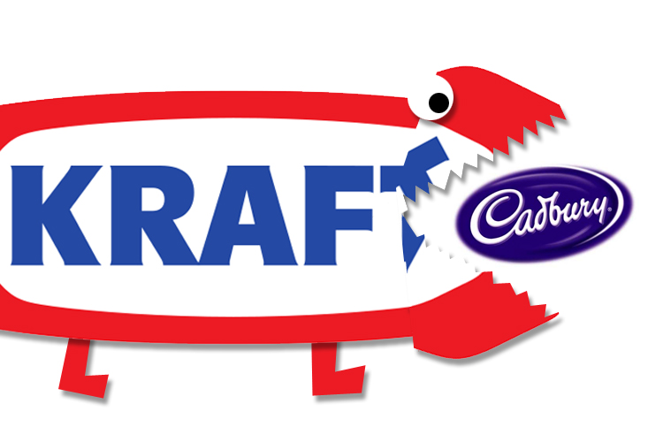
The “Deal”
Initial deal
300 pence cash and 0.2589 Kraft shares
Valued at 717 pence
Rejected by Cadbury, said it values it at a minimum of 850 pence
Final deal
500 pence cash ,0.1874 Kraft shares and 10 pence special dividend
Valued at 850 pence per share and at £11.5bn or $19.6bn
Finally accepted by Cadbury shareholders

Slide 22
Post Acquisition Analysis

Slide 23
Key Highlights
Kraft became world’s largest confectionary and 2nd largest food producer

Slide 24
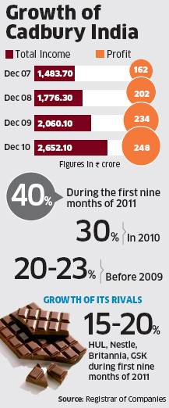
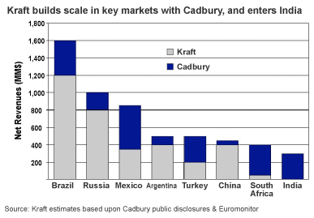
Key Highlights
Revenues in Europe rose by 33% and in North America rose by 6.3%
Cadbury helped to boost sales by 30%, net gain for the fourth quarter fell by 24%

Slide 25
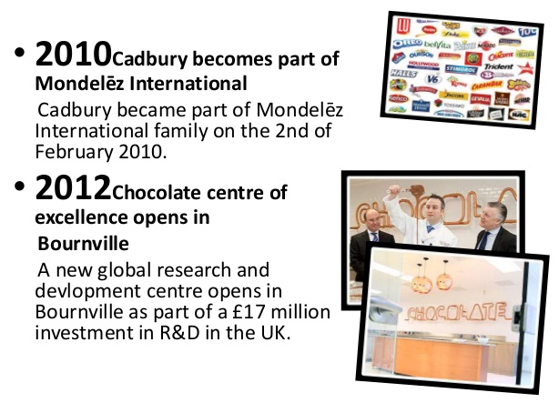
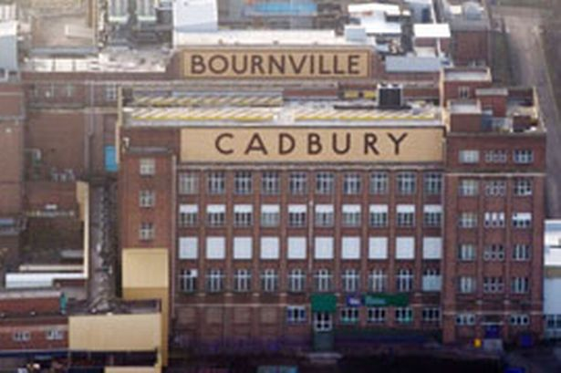
Key Highlights
Kraft Foods invest £17m at Cadbury’s Bournville site and turned it to “Global Centre of Excellence” for chocolate R&D
Includes new innovation laboratories

Slide 26
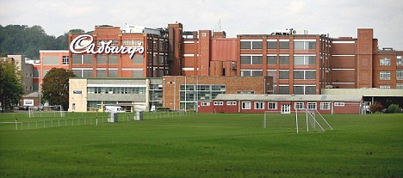
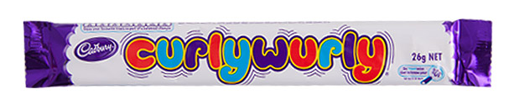
Key Highlights
Blunder: Shutdown of Cadbury’s Somerville Factory
Kraft vowed to keep this factory open but one week after the acquisition it was closed
Plant specialised in dipped chocolate bars, fry chocolate creams and famous Curly Wurly’s
This lead to a loss of more than 400 jobs
Kraft faced a lot of criticism and various campaigns
Explained its decision by saying that Cadbury has already invested lot in improving its Polish factories

Slide 27
Implications of Cultural Change
Kraft | Cadbury
Strengthened brand | Damaged heritage
Drives higher performance leading to better revenues | Lower moral and performance
Better control of organization | Staff burnout
Better reputation | Risk of losing benefit schemes
Efficiencies through alignment of processes | Trust issues
Alignment of goals | Changed brand personality

Slide 28

Split in 2012
CEO Irene Rosenfeld said:
Divide is the ‘next logical step’ for the company
Each side of the business (chocolate and cheese, basically) differ in their future strategic priorities, growth profiles and operational focus.
Divide is certainly not because Kraft is struggling
Grocery business worth approx $16bn
Brands: Mac & Cheese, Philadelphia, Singles
Targeted at North American market
Snack business worth approx $32bn
Brands: Oreo, Milka, Cadbury, Ritz
42% of revenues from emerging markets

Slide 29
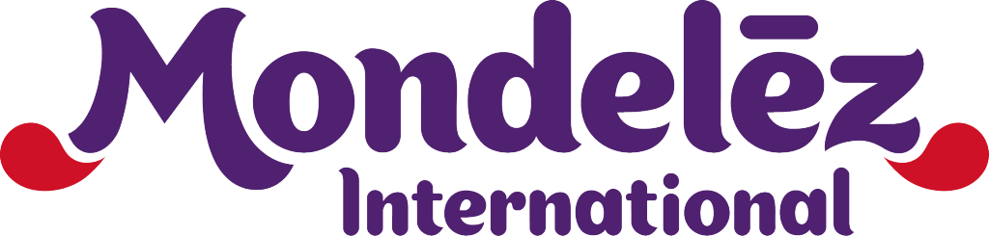
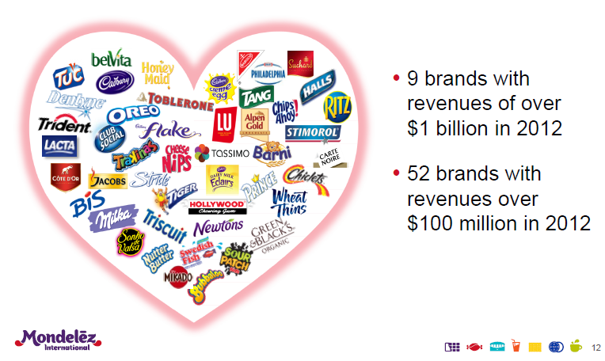
Mondelez INternational
On December 5, 2011, Kraft announced that Rosenfeld will stay on as chairperson of the $31 billion global snacking company, which will be called Mondelēz International, Inc.
The Mondelēz name, came from the input of
Kraft Foods employees at the time, Monde
being French for world and delez an
alternative to delicious.
It is particularly strong in chocolate,
biscuits, candy and powdered beverages.
Mondelēz International has annual revenue of
approximately $36 billion and operations in more
than 80 countries.
In January 2015, it laid cornerstone for construction of its new $90mn biscuit plant in Bahrain

Slide 30
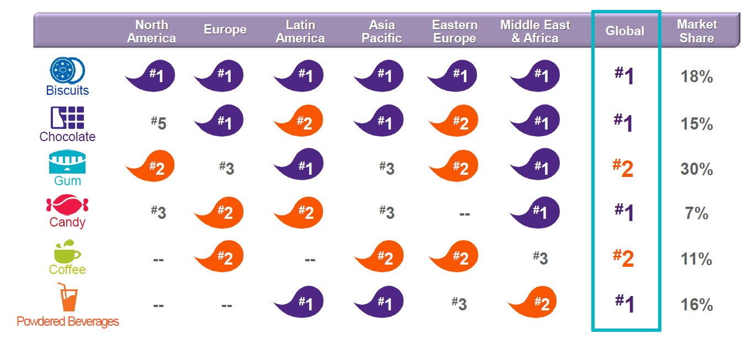
Mondelez Market share

Slide 31
VULNERABILITIES

Slide 32
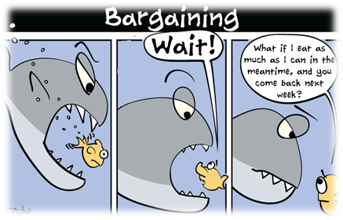
Bargaining Power of Suppliers
The food and beverage industry is quite competitive in nature
Prices offered are usually competitive to remain in the market
Suppliers in the industry do not hold much power to drive the company as a hostage to extract their profits
Suppliers are reliant on high volumes, thus have less bargaining power, because a producer can threaten to cut volumes and hurt the supplier’s profits.
Bargaining power of suppliers is low

Slide 33

Bargaining Power of Buyers
The buyers preferences changes with the passage of time and they are likely to switch to the seller who offers good quality at less price.
Wal-Mart has played a major role in this case. It offers less priced goods to attract the buyers’ attention.
There is a significant opportunity for the buyers to extract industry and firm profits.
At the same time, if customers cherish a particular product they end up paying more for that one product.
Bargaining power of buyers is medium.

Slide 34

Threat from New Entrants
There are already so many competitors present in the market that there are very less chances for the new comers to set foot in and enjoy there share in the market.
The existing companies have already spent so much on their brands, quality and positioning that it will be difficult for the new comers to entice switching among consumers.
Threat from new entrants is low.

Slide 35

Threat from Established Competitors
Intense competition lies in food and beverage industry.
The Industry is characterized by a constant quest for preserving and increasing market share through loyalty and diversification
The products here are highly elastic with customers weighing the trade off between price and quality between companies and products.
Hence, the vehicle to maintain market share is to provide brand quality at an affordable price
Threat from established competitors is high

Slide 36

Threat of Substitutes
Consumers evaluate the quality of products and their prices with that of substitutes to decide which product to buy
‘Generic’ products pose a serious threat to firm’s profits
They prevent company from passing on higher input prices to consumers
Rise of motion for healthier food forced Kraft to raise its own standard
Threat of substitutes is high

Slide 37
Ingredient Costs
Rising commodity prices(especially meat and cheese) has hit Kraft badly
Kraft pointed to escalating expenses as “one of the most significant cost pressures we faced in 2014”
To counter, it raised prices for 50% of its products in July last year
But it proved to be a one big hurdle in winning back shoppers

Slide 38
Changing Tastes
US consumers are showing a stronger preference for natural and organic ingredients.
A large part of Kraft’s portfolio remains unattractive with new generation
Even its classic Mac and Cheese product faces an encroachment from organic sellers such as Annie’s

Slide 39
Management
Kraft’s leadership has been in turmoil, with many of its top executives heading for the exits
CEO Tony Vernon, who took over the business after the split from Mondelez in 2012, abruptly left the company in December 2014
Kraft made more changes to the C-Suite after the company’s top finance and marketing executives departed

Slide 40
US Focus
Idea behind 2012 split was to have Mondelez tap international market while Kraft focused on North America
But it made Kraft bereft of overseas opportunities for growth
While Mondelez can peddle its snacks and gum to China and emerging economies, Kraft was left to puzzle out a mature U.S. market
Kraft sales were stagnant in 2014, and analysts have only been predicting growth of 1 percent for 2015

Slide 41
Recommendations
Optimize between quality and cost to counter ingredient costs
Add more healthier and nutritional products to the brand owing to changing tastes
Counter the attrition at management level
Must compete on price and quality of product
Must spend an increasing amount on advertising and marketing

Slide 42
References
wikiwealth.com
http://www.wikiwealth.com/five-forces:kraft-foods-group
ukessays.com
http://www.ukessays.com/essays/marketing/kraft-foods-inc-company-analysis-marketing-essay.php
Bloomberg
http://www.bloomberg.com/news/articles/2015-03-25/the-four-challenges-that-turned-kraft-foods-into-a-merger-target

Slide 43
References
http://www.mondelezinternational.com/Newsroom/Multimedia-Releases/Kraft-Foods-Lays-Out-Its-New-Global-Growth-Strategy
http://businesscasestudies.co.uk/kraft-foods-uk/using-planning-analysts-at-the-centre-of-brand-development/new-product-development.html#axzz3hp14Zs8T
http://www.mondelezinternational.com/~/media/MondelezCorporate/Uploads/downloads/mondelez_intl_fact_sheet.pdf
https://www.scribd.com/doc/119344632/Kraft-Foods-BCG
https://prezi.com/-owq53lhy3sh/kraft-foods-group/
http://www.slideshare.net/JOTAA27/kraft-analysis

